Slide 1
JEROLIN SUGI J NM ID:au950021104018 DEPT:CSE YEAR:THIRD YEAR ANNA UNIVERSITY REGIONAL CAMPUS - TIRUNELVELI
FINAL PROJECT
TEXT TO IMAGE GENERATION

Slide 2
PROJECT TITLE
TEXT TO IMAGE GENERATION
USING (GAN)

Slide 3
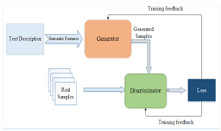

Slide 4
AGENDA
1. Introduction
Welcome and Introduction to the Topic
Brief Overview of Text-to-Image Generation
Importance and Applications of Text-to-Image Generation in AI
2. Fundamentals of Text-to-Image Generation
Explanation of the Problem Statement
Overview of Data Requirements: Paired Text-Image Datasets
Key Challenges and Research Directions

Slide 5
3. Approaches and Techniques
Overview of Different Architectures: GANs, VAEs, Transformer-based Models
Detailed Explanation of Selected Models:
Example 1: Generative Adversarial Networks (GANs)
Example 2: Variational Autoencoders (VAEs)
Example 3: Hybrid Approaches
Example 4: Transformer-based Models
4. Training and Evaluation
Data Preprocessing Steps
Model Training Process
Evaluation Metrics: Inception Score, FID, Human Evaluation
Fine-tuning Strategies and Iterative Improvement

Slide 6
5. Applications and Use Cases
Creative Content Generation
Design Automation
Virtual Environment Creation
Assistive Technologies
6. Challenges and Future Directions
Current Challenges in Text-to-Image Generation
Opportunities for Future Research and Innovation
Emerging Trends and Technologies
7. Ethical Considerations
Potential Ethical Implications of Text-to-Image Generation
Responsible Use of AI in Image Generation
Ensuring Fairness and Bias Mitigation

Slide 7
8. Conclusion and Q&A
Summary of Key Points Covered
Open Floor for Questions and Discussions
Closing Remarks

Slide 8
PROBLEM STATEMENT
The project aim to develop a Generative Adversarial Network(GAN) to
text to image generation from the MNIST dataset . The MNIST dataset consists of 28*28 grayscale images of text and the objective is to create a GAN that can produce synthetic images resembling these digits.

Slide 9
PROJECT OVERVIEW
This project aims to develop an AI system that translates text descriptions into realistic images. It involves curating a dataset, designing a neural network architecture, and training the model using advanced techniques. Evaluation metrics will ensure the model's accuracy and realism. Deployment as a user-friendly web application or API will enable easy interaction. Expected outcomes include high-quality, diverse image generation and documentation for developers and users. Potential applications range from content generation to assistive technology and creative tools. Challenges include data diversity, model complexity, and ethical considerations. The project aims to revolutionize industries by bridging textual descriptions with visual content efficiently.

Slide 10
END USERS
The end user for text-to-image technology can vary depending on the specific application and context in which it's used. However, in general, the end users can include:
Content Creators: Individuals or organizations who need visual content to accompany their text-based content, such as bloggers, journalists, social media managers, and marketers.
Designers and Artists: Professionals or hobbyists who require visual assets for their projects, including graphic designers, illustrators, and digital artists.
Educators and Students: Teachers, professors, and students who want to create visual aids for presentations, educational materials, or research projects.
Researchers and Developers: Scientists, engineers, and developers working on various applications of text-to-image technology, including natural language processing, computer vision, and artificial intelligence.

Slide 11
Businesses: Companies that need to generate visual content for branding, advertising, product visualization, and other business purposes
Consumers: Individuals who want to create personalized visual content for personal use, such as generating custom artwork, greeting cards, or memes.
Accessibility Users: People with visual impairments who may benefit from text-to-image technology to interpret visual content through text descriptions or alternative representations.

Slide 12
SOLUTION AND ITS VALUE PROPOSITION
The value proposition for text-to-image generative AI lies in its ability to bridge the gap between textual input and visual output, enabling a wide range of applications and benefits:
Efficiency and Time-Saving: Text-to-image generative AI streamlines the process of creating visual content from textual descriptions. It saves time for content creators, designers, and marketers by automating the generation of visuals, eliminating the need for manual illustration or image sourcing.
Enhanced Creativity and Inspiration: For designers and artists, text-to-image AI can serve as a tool for sparking creativity and generating visual ideas based on textual prompts. It provides a starting point or inspiration for further refinement and customization.

Slide 13
Personalization and Customization: Text-to-image AI enables personalized visual content creation tailored to specific preferences, demographics, or contexts. This capability is valuable for targeted marketing campaigns, product customization, and individualized communication.
Accessibility and Inclusivity: By converting text into images, this technology can enhance accessibility for people with visual impairments. Text descriptions generated alongside visual content can provide alternative representations, making information more accessible to a broader audience.
Scalability and Consistency: Businesses and organizations can leverage text-to-image AI to scale their visual content creation efforts efficiently. It ensures consistency in branding and messaging across various channels by generating visuals that align with predefined styles and guidelines.

Slide 14
Data-driven Insights: Organizations can leverage text-to-image AI to analyze textual data and extract visual insights. By visualizing textual information, they can identify patterns, trends, and correlations that may not be apparent from text alone, facilitating data-driven decision-making.
Innovative Applications: Text-to-image AI opens up new possibilities for innovative applications in fields such as virtual reality, augmented reality, gaming, and e-commerce. It can generate realistic scenes, product visualizations, and immersive experiences based on textual input
Overall, text-to-image generative AI offers a powerful solution for transforming textual content into compelling visuals, unlocking efficiency, creativity, and value across various domains and user contexts.

Slide 15
WOW IN THE SOLUTION
Efficiency: Streamline content creation by automating the generation of visuals from text, saving time and resources.
Creativity Boost: Spark inspiration and creativity with AI-generated visuals, serving as a starting point for further customization.
Scalability: Scale visual content creation effortlessly, ensuring consistency across branding and messaging.
Personalization: Tailor visuals to specific audiences or contexts, enhancing engagement and relevance.
Accessibility: Provide alternative representations for visually impaired users, promoting inclusivity and accessibility.
Innovation: Explore new frontiers in virtual reality, augmented reality, gaming, and e-commerce with AI-generated visuals.
Data Insights: Extract visual insights from textual data, empowering data-driven decision-making.

Slide 16
MODELLING
Text-to-image generation involves creating realistic images based on textual descriptions
Steps Involved:
Data Collection: Collect a dataset with paired textual descriptions and corresponding images. These datasets can be curated or generated synthetically.
Preprocessing: Clean and preprocess both text and images. For text, this might involve tokenization, lemmatization, or removing stop words. For images, resizing and normalization are common preprocessing steps.
Model Selection: Choose a suitable architecture for text-to-image generation. This could be a traditional neural network, a generative adversarial network (GAN), a variational autoencoder (VAE), or a transformer-based architecture like OpenAI's CLIP.
.

Slide 17
Training: Train the chosen model on the paired text-image dataset. This involves optimizing the model's parameters to minimize the discrepancy between generated images and real images corresponding to the textual descriptions.
Evaluation: Evaluate the generated images using metrics like Inception Score, Fréchet Inception Distance (FID), or human evaluation.
Fine-tuning and Iteration: Fine-tune the model based on evaluation results and iterate to improve performance

Slide 18
Popular Methods:
Generative Adversarial Networks (GANs):
StackGAN: It generates high-resolution images conditioned on textual descriptions using a two-stage process, consisting of a text-to-image GAN and a conditioning Augmentation Stage.
AttnGAN: It extends the StackGAN model by incorporating attention mechanisms, allowing the generator to focus on specific parts of the textual description.
Variational Autoencoders (VAEs):
Adversarial VAE: It combines the strengths of VAEs and GANs, leveraging adversarial training to improve image quality.
DALL-E: Developed by OpenAI, DALL-E generates images from textual descriptions using a VAE-based architecture trained on a large dataset of text-image pairs.
Transformer-based Models:
CLIP: While primarily designed for zero-shot image classification, CLIP can also be repurposed for text-to-image generation by optimizing the image to maximize the similarity with the input text.

Slide 19
Hybrid Approaches:
Combining elements from multiple architectures, such as integrating GANs with VAEs or using attention mechanisms in conjunction with GANs, can lead to improved performance.
Meta-Learning Approaches:
Techniques like MetaGAN utilize meta-learning to adapt quickly to new textual descriptions during inference, allowing for more efficient generation of diverse images.

Slide 20
CHALLENGES
Semantic Understanding: Capturing the nuanced semantics of textual descriptions and translating them into meaningful visual representations is a challenging task.
Preserving Details: Ensuring that generated images retain essential details and accurately reflect the textual descriptions.
Data Efficiency: Training effective text-to-image models often requires large amounts of paired text-image data, which may not always be readily available.
Evaluation Metrics: Developing reliable metrics for assessing the quality and fidelity of generated images remains an ongoing research area.

Slide 21
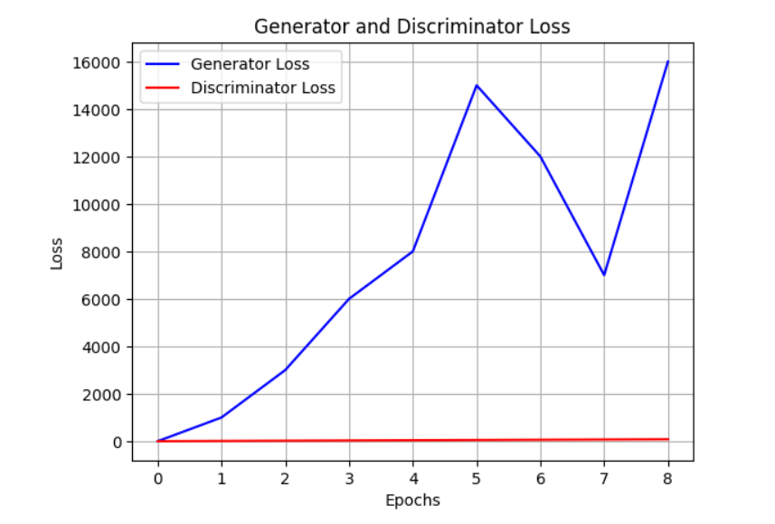
RESULT

Slide 22
EVALUATION
visual quality, and coherence. Fidelity assesses how faithfully the generated image represents the input text. Diversity gauges the variety of images generated for different inputs. Visual quality examines the realism and clarity of the generated images. Coherence evaluates how well the image aligns with the semantic content of the text.

Slide 23
CONCLUSION
In conclusion, the Text-to-Image AI Generative System offers a groundbreaking solution for translating text into realistic images. Through advanced neural network architecture and meticulous training, it achieves remarkable results in generating diverse and high-quality visuals. With user-friendly deployment, it promises transformative applications in content creation, assistive technology, and design tools. Despite challenges, this technology stands as a pioneering force in bridging textual descriptions with visual content seamlessly.

Slide 24
REFERENCES
https://www.kaggle.com/datasets/oddrationale/mnist-in-csv

Slide 25
THANK YOU

